Slide 1
Dog “Simulator” Toy
A Small Canine Friend
By the New York Rat, Sydney Gardner

Slide 2
Essential Features
The dog’s eyes will blink every few seconds
The dog’s eyes will follow the mouse cursor around (if the cursor moves off the Perlenspiel grid and cannot be tracked, the dog will look forward again)
If the user clicks the dog’s eyes, it will wince. If clicked anywhere else, the dog will bark.
Non-essential features:
Petting the dog (An extra activity)
Extra head turn (Some bonus aesthetics)

Slide 3
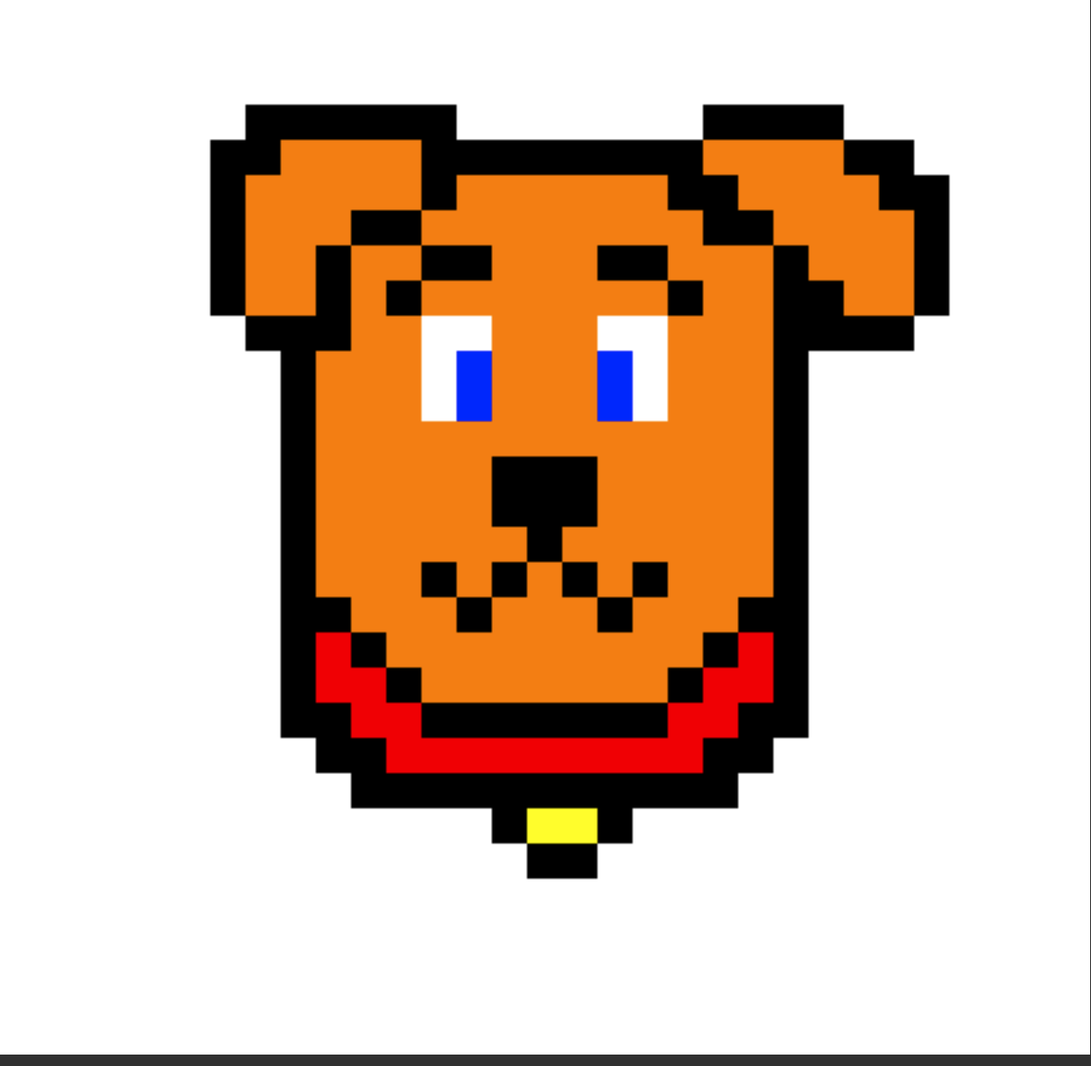
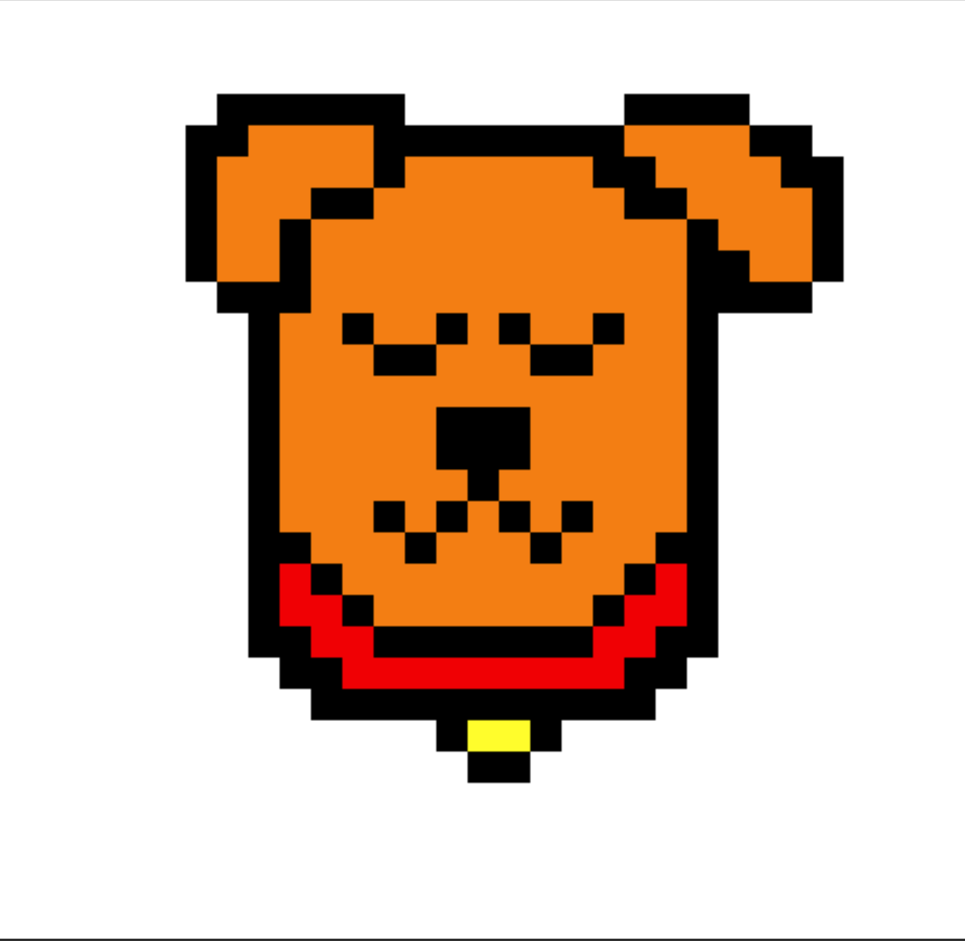
The Default Dog
First image shows the default dog, looking straight forward. This will be if the cursor is directly in front of the dog or if it is off the designated Perlenspiel grid.
Second image shows the eyes closed for a blink, which will occur every few seconds when the dog is idle.

Slide 4
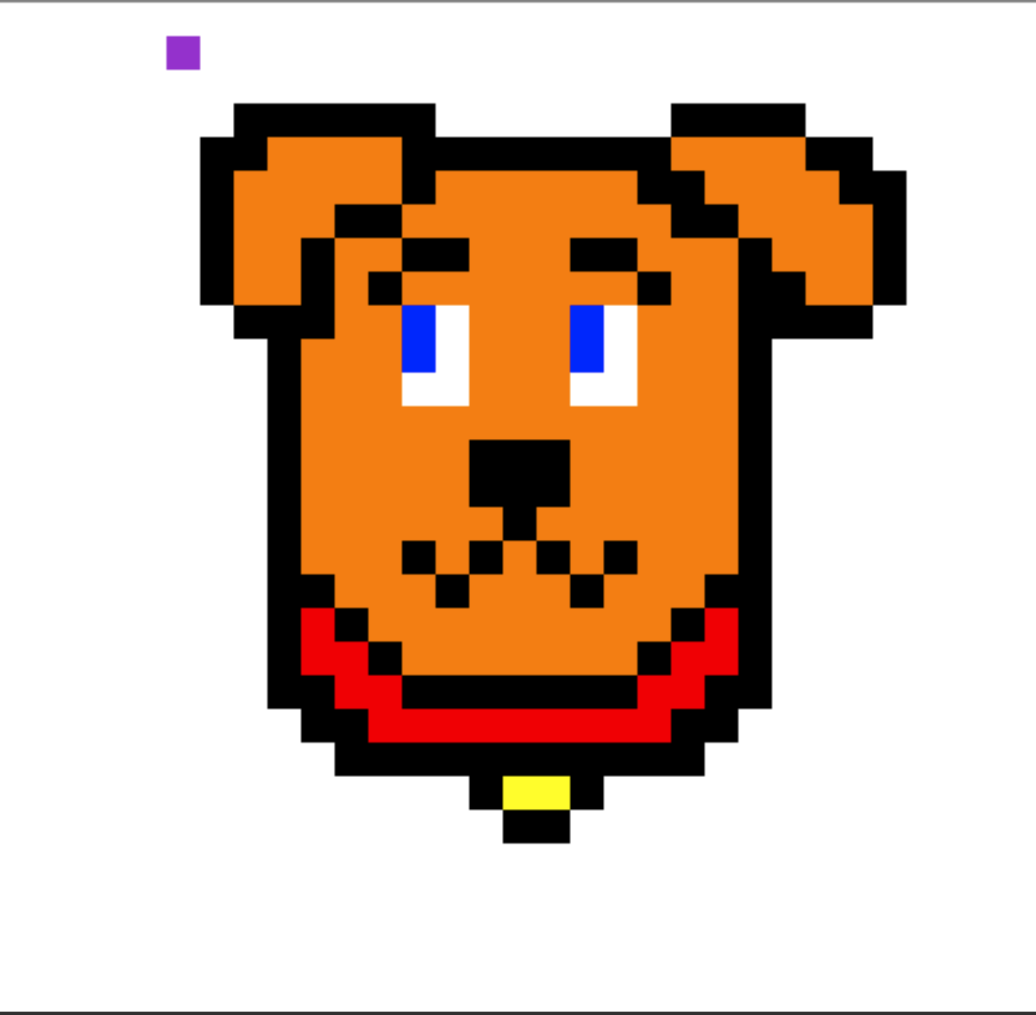

Look!
Image shows the dog looking at the cursor (represented as purple) in the upper left side of the screen.
Second image shows the eyes looking at the cursor at the lower right, representing that it is following it.

Slide 5
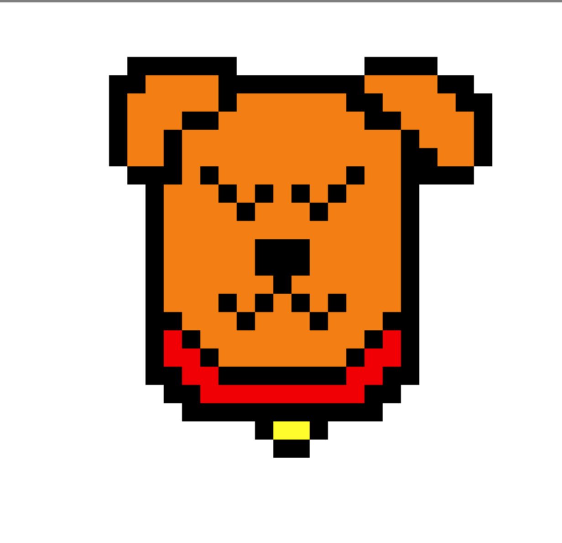

Speak!
Image shows the dog getting ready to bark. It will close its eyes as anticipation.
Second image shows the dog barking, and there will be animation for the dog’s eyes and jaw to move.
This will occur if the mouse is clicked anywhere but the eyes.

Slide 6
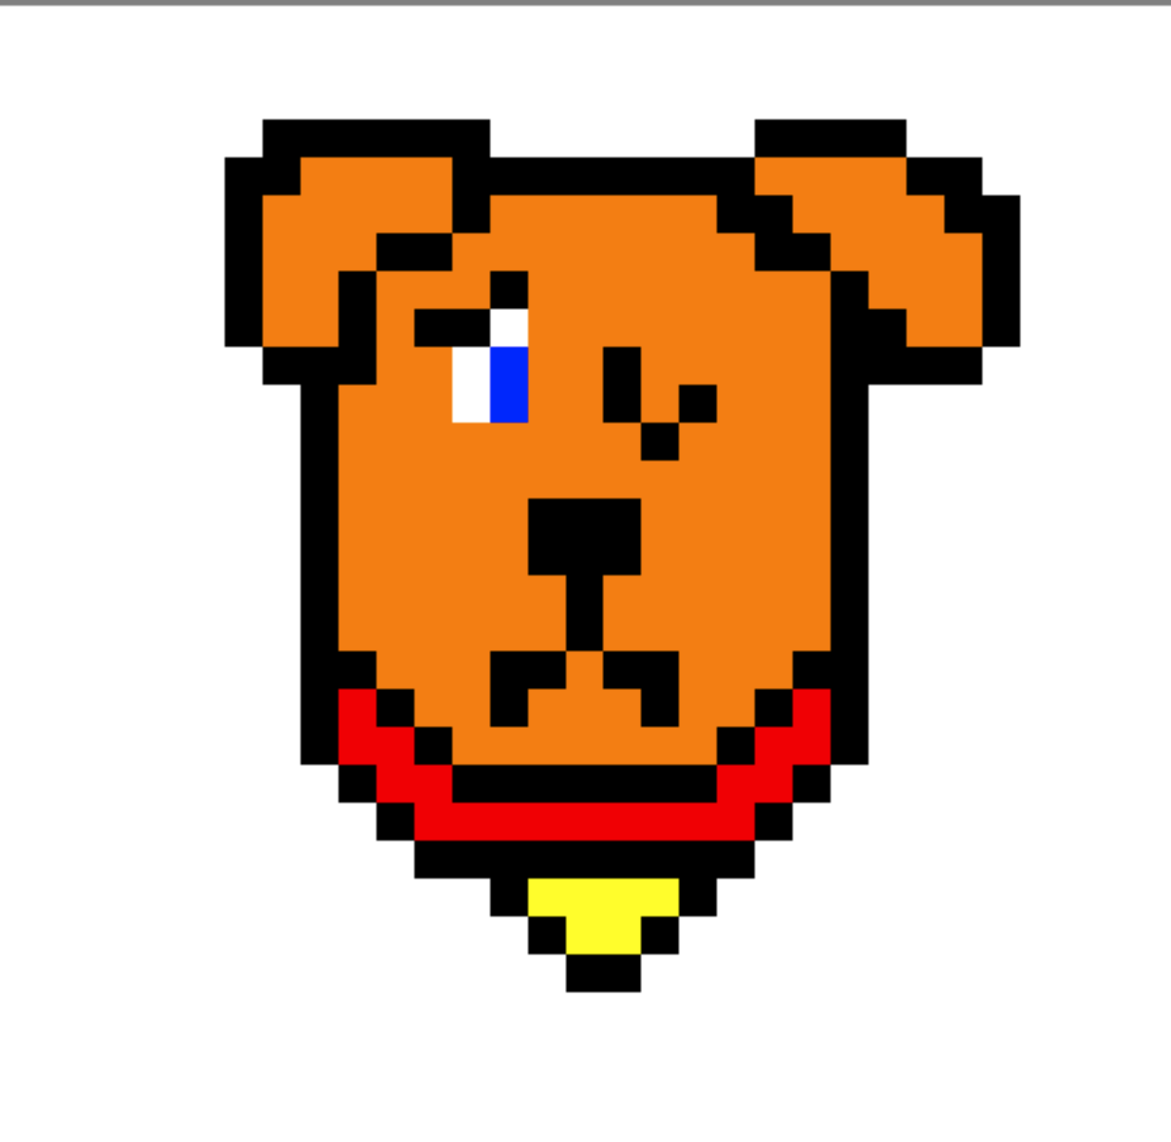
Ouch!
If the mouse is clicked on one of the dog’s eyes, it will wince and frown.

Slide 7

Extra Concept: Pet!
If the cursor is clicked and held on the dog (not on the eyes) it will be pet. This will make the dog close its eyes with a happy expression, and will remain so while the cursor is held down over the dog.

Slide 8
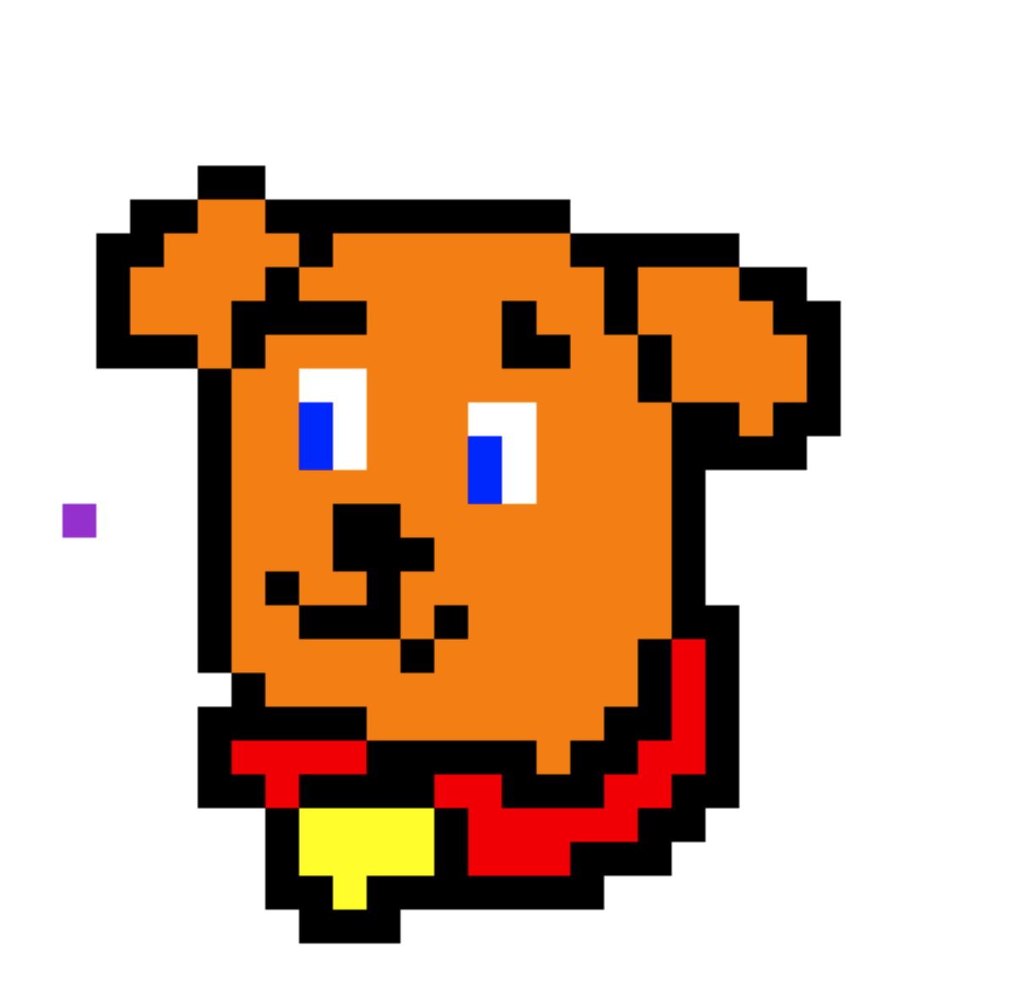
Extra Concept: Looking Further
If the cursor is closer to the far edge of the screen, the dog’s entire head will “turn” towards it. This would require refinements to how the eyes track and how the animations will be done, but if I have time this will be at least attempted.

